Slide 1
User Centered Design in an Agile Scrum Environment

Slide 2
What makes Agile attractive?
Quicker Return On Investment (ROI) for development effort
Earlier software release
Good at generating momentum
Good at avoiding feature bloat
Encourages contributions from different perspectives

Slide 3
So, what is the problem?
It does not help the business know what it wants

Slide 4
Problem 1: An unclear role for design
Not all developers have design skills
Many developers have had bad experiences with designers who don’t know what they’re doing

Slide 5
Problem 2: The requirements gathering process is not defined
Agile accommodates design activities from the perspective of a developer
It assumes requirements fall from the sky
  or at least from the business or customer who is assumed to be all-knowing
Too often the good parts of a waterfall process (e.g. research and forming a high-level blueprint for the overall design) become the proverbial “baby thrown out with the documentation bathwater”

Slide 6
Problem 3: Pressure to cut corners
Scrum puts tremendous pressure on the experience design team to ‘feed the development machine’ in time enough for them to implement their vision.
But user centric principles suggest you should test ideas with end users before committing them to code

Slide 7
Problem 4: The temptation to call it “good enough”
Agile condones releasing whatever we have so long as it works.
Sometimes, that means doing what we can get away with, not what is ultimately best for the user.
Rework gets left in favour of exciting new stuff.
The end product may be full of features that don’t quite meet requirements.

Slide 8
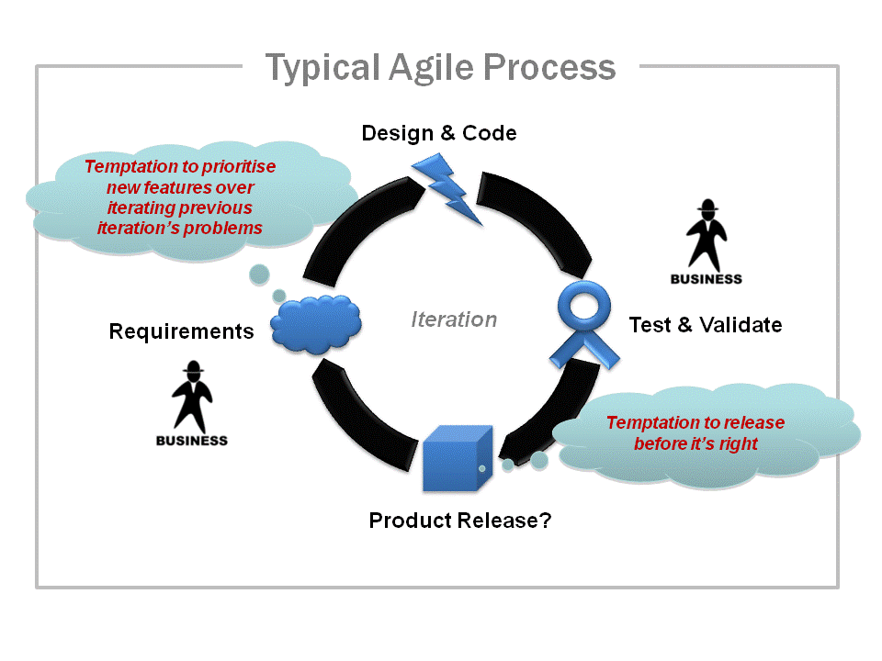

Slide 9
Problem 5: Insufficient risk-free conceptual exploration time
Iteration “zero” (i.e. a planning and design iteration prior to the first development iteration) can be used for planning
However, the level of rigor applied to exploration may be insufficient.
Agile does not dedicate time to “concept activities” such as sketching different solutions at a high level and validating them in the rough with users before digging into detailed design or code.

Slide 10
Problem 6: Brand Damage
Repeatedly foisting a botched product design on users will adversely affect the “brand”
Brand damage takes far longer to mend than it does to make.
“Good enough" software creators who fail to innovate through conceptual exploration put their companies revenues at risk

Slide 11
So, why use Agile?
Agile is good for refining, not defining.
Developing existing products to the next level, means you have a base upon which to improve.
Your requirements have been properly informed with user research, comparative analysis and business objectives

Slide 12
What about UCD?
User Centered Design requires iteration – design, test with users, refine, test with users again, refine… repeat till it’s right.
Agile and UCD can work brilliantly together.
Agile is about assuming you’ll need to change things, and that’s a good thing when it comes to refinement.

Slide 13
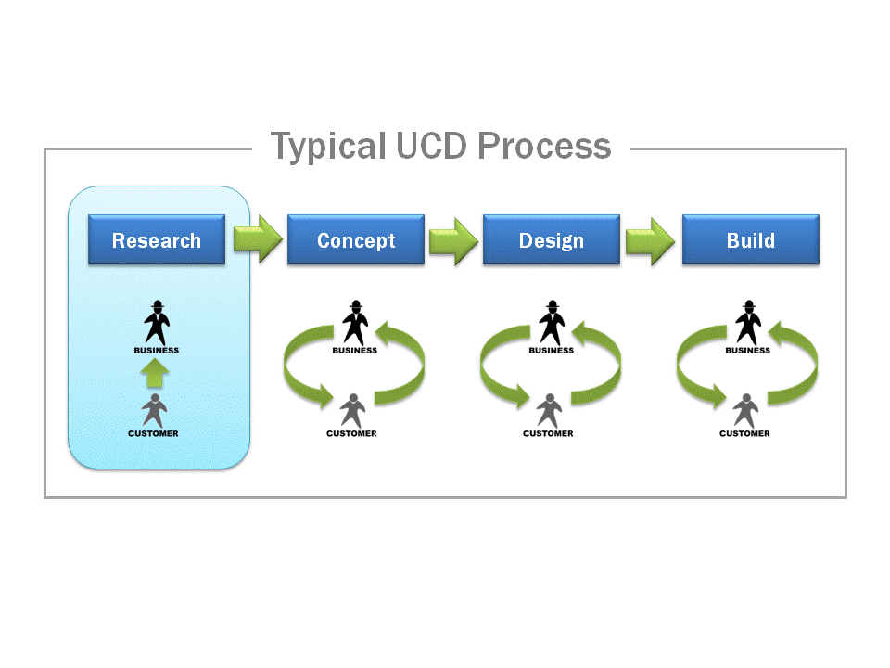

Slide 14
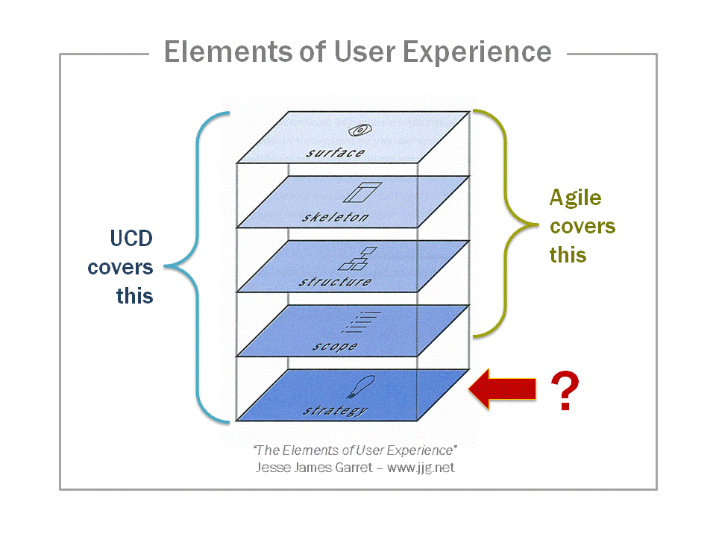

Slide 15
Using UCD to form a strategy
Empathetic qualitative research that uncovers the user’s context, needs, goals and attitudes i.e. determine user requirements
A thorough appreciation of what else already exists in terms of products, features and technology
A clear articulation of the business problem, objectives, success measures and constraints.

Slide 16
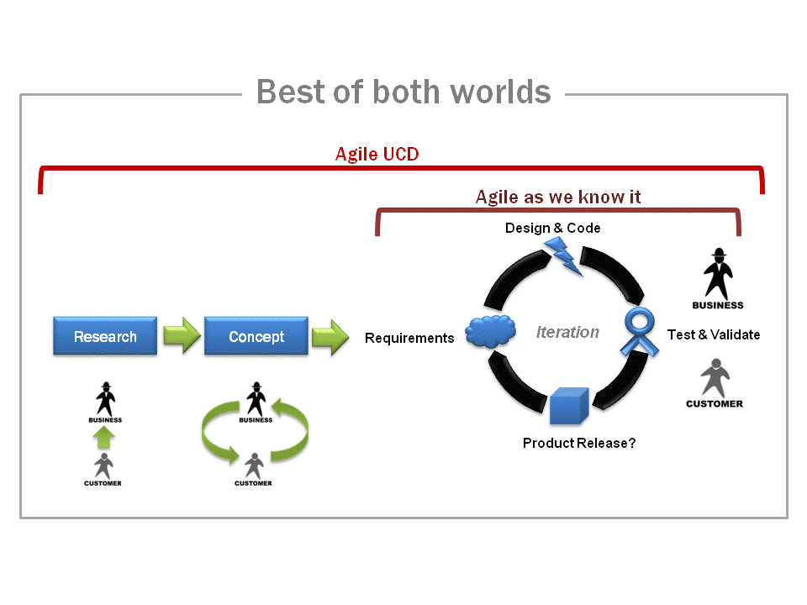

Slide 17
Conclusion
There is no “magic bullet” for software development
Agile SCRUM has many positive features
UCD also has many positive features
Agile SCRUM and UCD can work well together
There are many other approaches to software development.

